Slide 1
Using Classification and Clustering to Model Economic Development Status
By: Lloyd Page and Colin Schultz

Slide 2
Introduction
Countries are divided into 2 categories: developed and developing.
This division is commonly used to test for differences between the 2 groupings.
However, UN notes that there is no established convention.
Goal: use classification and clustering methods to test how arbitrary these designations are, and if there is a better way to group countries.

Slide 3
The Data
Taken from World bank, IMF.
Used IMF’s advanced economy status to decide when/were is “developed”
Lots of missing values, so we dropped those.
Death rate, Inflation rate, Unemployment rate, Urban Population (%), and GDP per capita used

Slide 4
Classification
We used a Decision Tree classifier
It proved to be the most accurate algorithm in preliminary testing
It’s also generally easy to understand

Slide 5
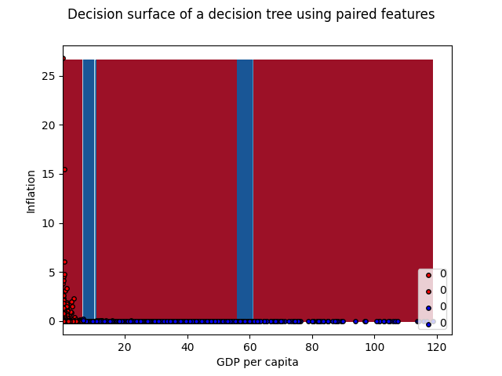
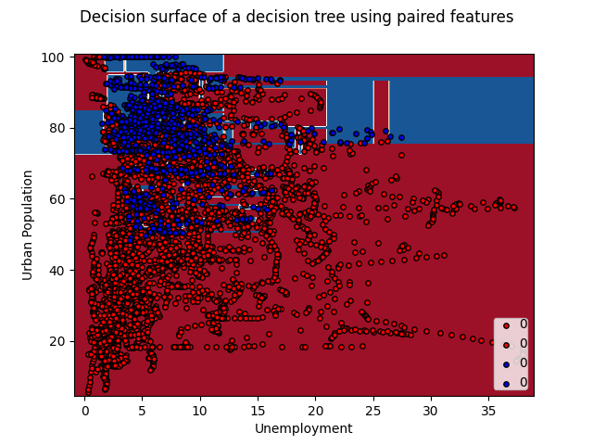
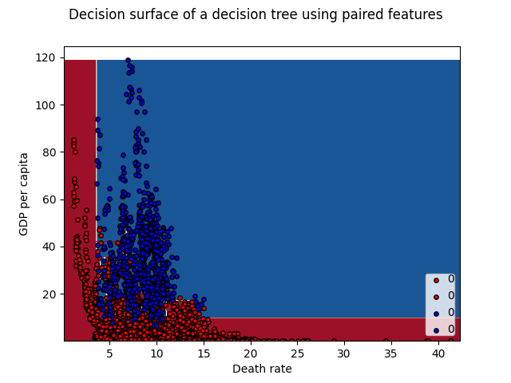
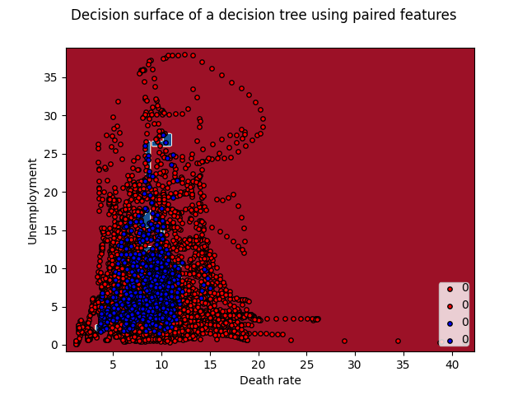
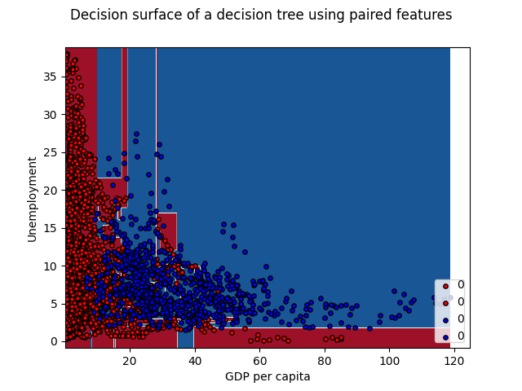
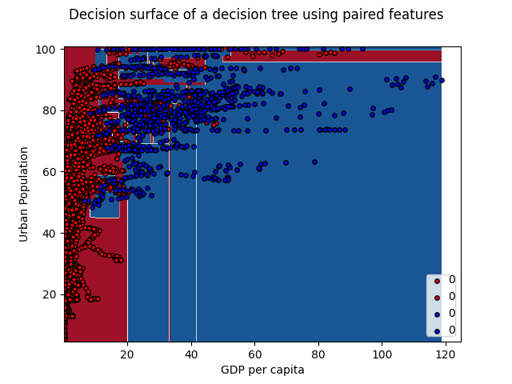
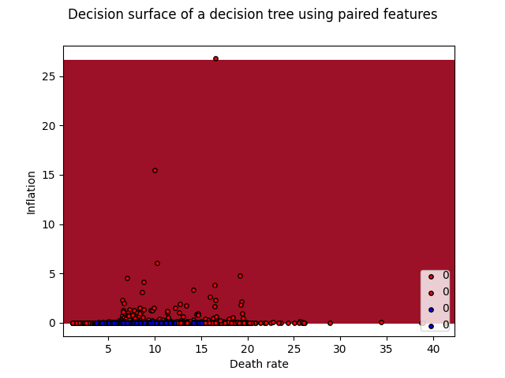
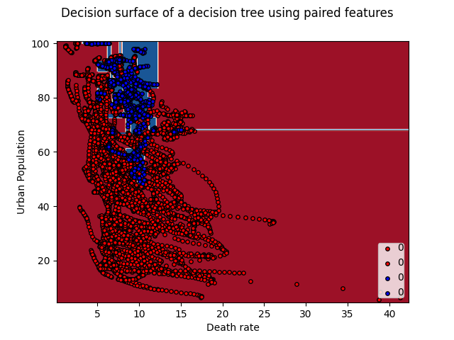
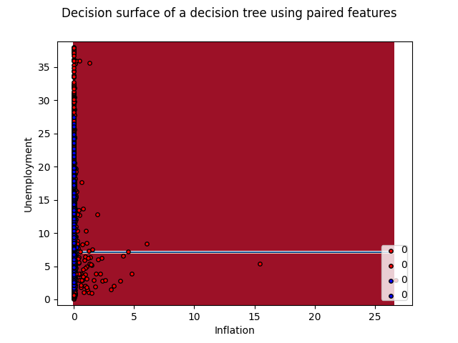
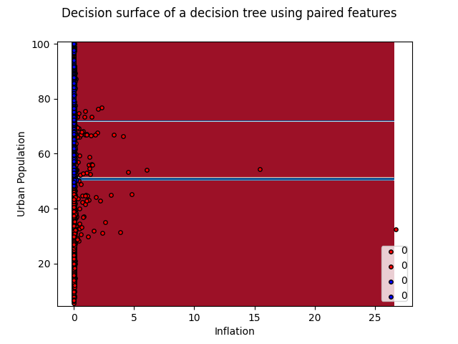
Classification
Notes:
2-D Decision surface, blue=developed, red=developing

Slide 6
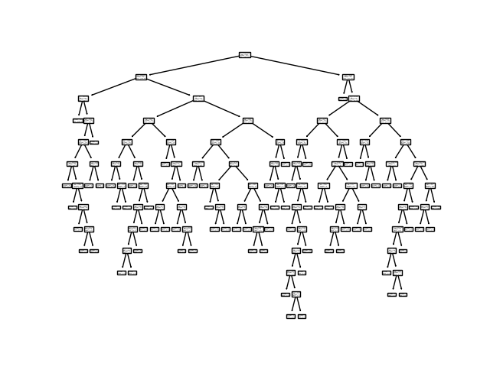
Classification
Decision Tree had 97.1% accuracy (98.1% on developing, 92.7% on developed)
Tree is complex (13-levels deep)

Slide 7
Clustering
We used Hierarchical Density Based Scan.
This creates a reachability matrix for a minimum span tree.
It then creates a hierarchy of nodes starting from the great distance.
Finally it clusters the data.
Visualization is accomplished with manifold learning.
We used t-distributed Stochastic Neighbor Embedding.

Slide 8
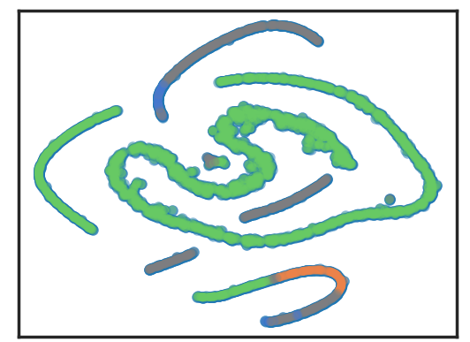
Clustering
Green - Developing Countries
Blue - Developed Countries
Orange - Developed Countries
Grey - Not Clustered / Noise

Slide 9
Clustering
125 of the 871 developed countries were properly clustered.
3591 of the 4004 developing countries were properly clustered.
197 data points were clustered into the wrong cluster.
962 points of data were saw as noise to the algorithm.

Slide 10
Conclusion
We either have too little developed country data to reasonably cluster them well, or we have 3 groups.
Despite the complex decision tree, it appears that this division method works well when dividing countries into 2 groups. Although, given the lack of a clean split, there’s clearly been some misclassification.

